Slide 1
Puzzled Billiards
Project Plan
Hi Sharks, we are requesting $100k for 10% equity
This is our game, our game is amazing, give it lick, mmm, tastes like raisins XD

Slide 2
Game Pitch
Inspiration:
Mini-golf
Billiards
Puzzle and Mechanic Skill Based Game
Main Objective:
Sink the objective ball by solving the puzzle
Main Mechanic:
Drag, Aim and Shoot
Notes:
James to give game pitch:
Introduction
- Drawing of level design that James will visually represent to the peeps - mechanics
- Mention ideas to other game mechanics that are possible within the game that has been conceptualised
-We all feel a little differently about certain mechanics such as the scoring but we have decided to use
Introduction to the game

Slide 3
Level Design
Micro Goals:
Introduce and guide the player
Present new challenges
Macro Goals:
Keep the player engaged and in a good flow of anxiety and frustration
Difficulty and flow:
Various game objects are used to create complex and contextual difficulty

Slide 4
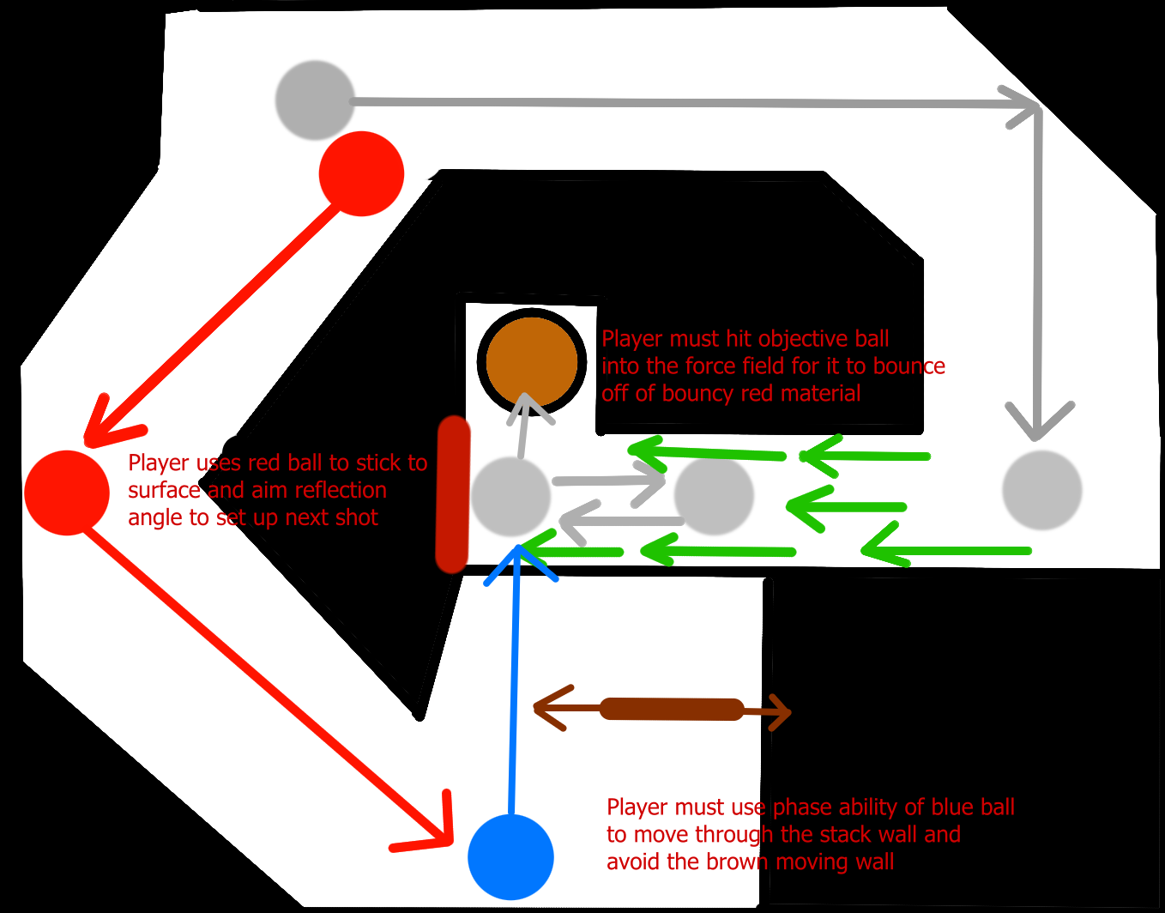
Concept and Technical Art

Slide 5
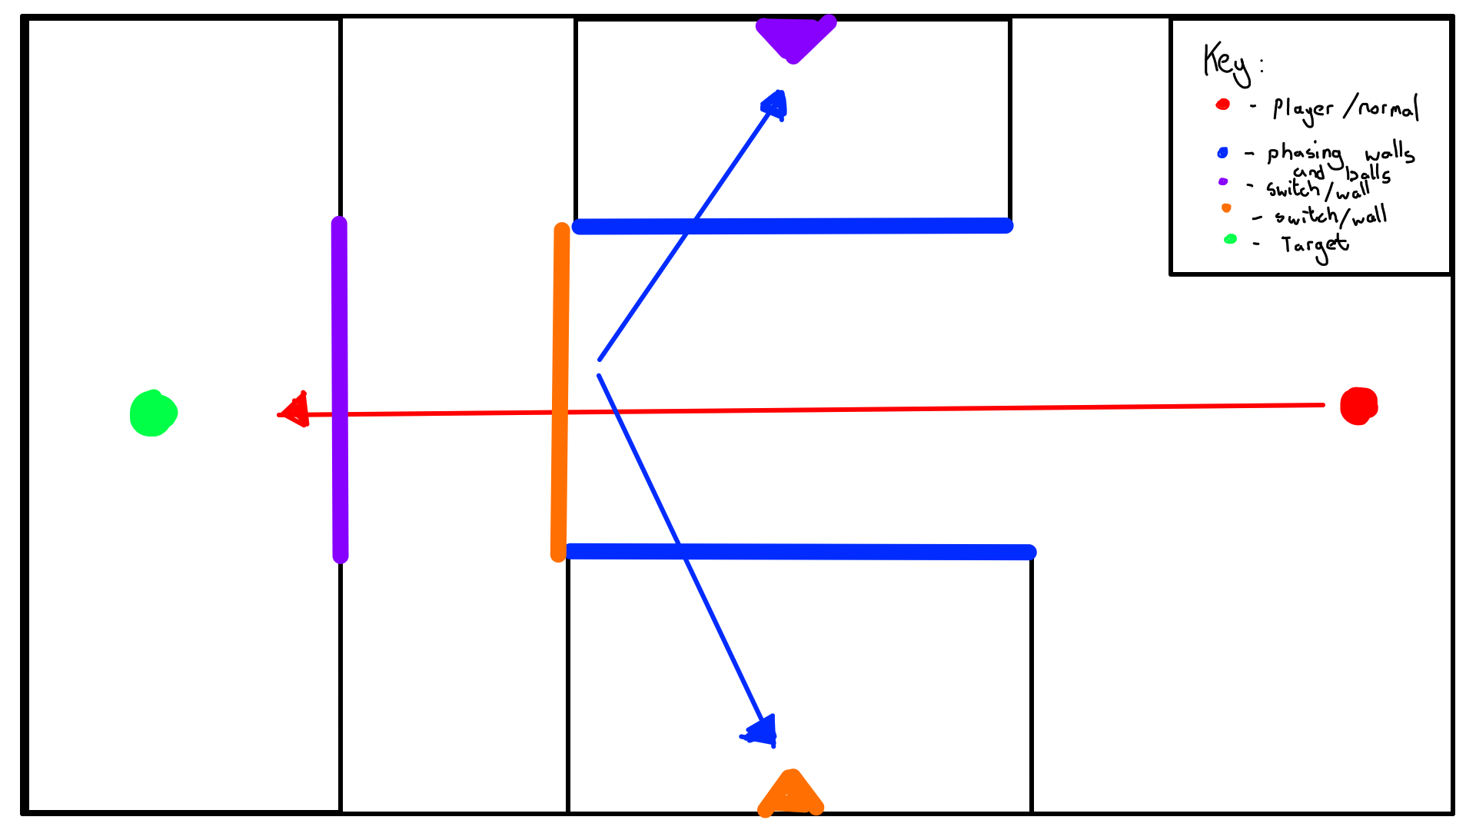
Concept and Technical Art
Notes:
This Level is designed around the use of environmental puzzle elements, requiring the player to utilise the Ability Ball to hit certain wall switches in a specific order to pass the level. The blue ability ball can phase through the colour coded walls, once the ball has phased through it then becomes solid. Using this mechanic, as well as the colour coded game objects, players must hit the colour coded wall switches, in order to deactivate the walls in a specific order while attempting to get the red objective ball to the green target and beat the level.

Slide 6
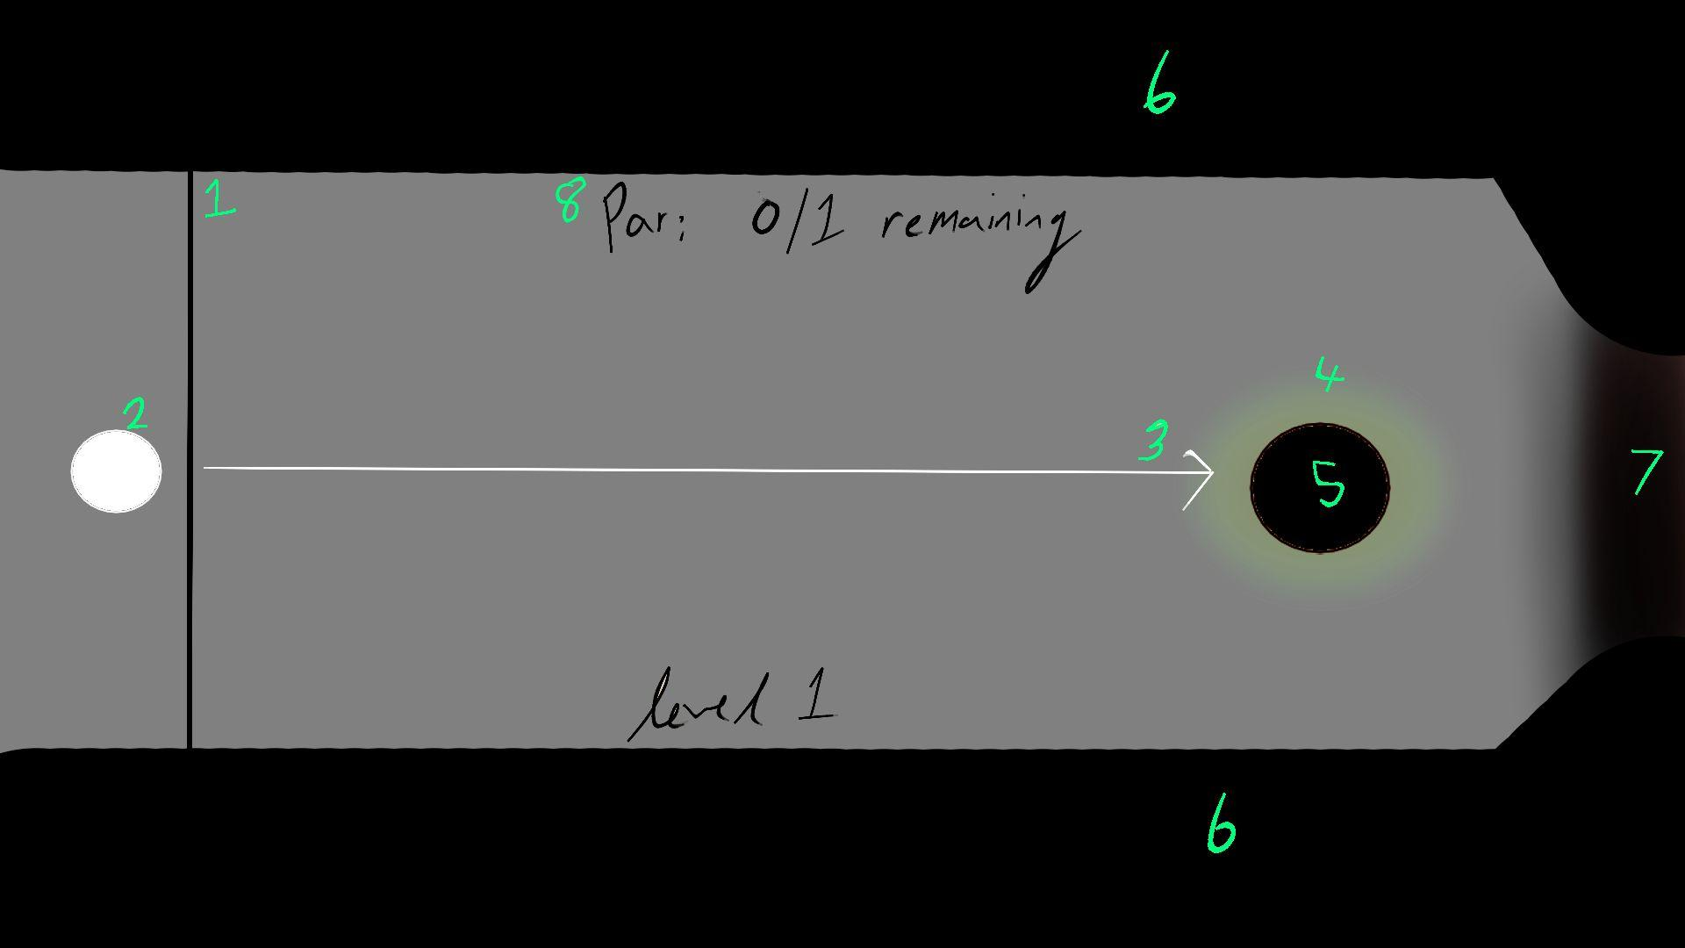
Concept and Technical Art

Slide 7
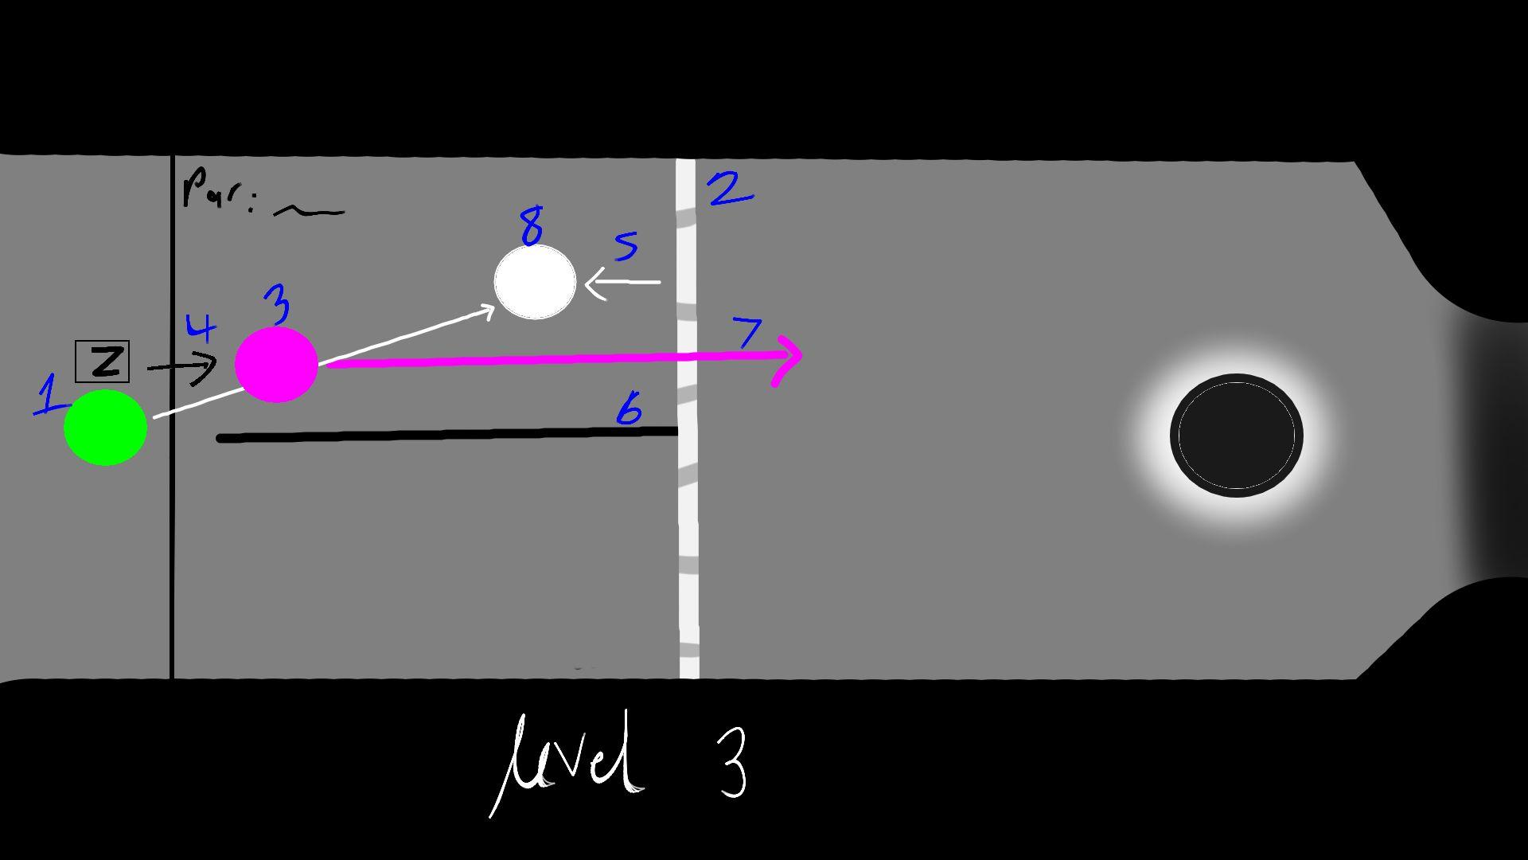
Concept and Technical Art

Slide 8
Communication Design
How do we indicate an action/effect to the player without directly telling them?
Visual Indicators
Colour Coding
Aim indicators
Distinct Shapes and Designs
Ball Effects
Unique Design
Particle Effects
Movement and ability effects
Player User Interface
Ball type
Ball Ability Count
Button Prompts
Notes:
How do we indicate an action and/or effect to the player without directly telling them, this was our main question as how to approach communication design. We discussed various ways of how to feed info to the player, without the use of text. Through discussions, we have came across a few visual indicators and effects, to help the player understand what is currently happening in game. Methods such as colour coding, distinct shapes and designs as well as particle effects help to enhance the game and its communication design.

Slide 9
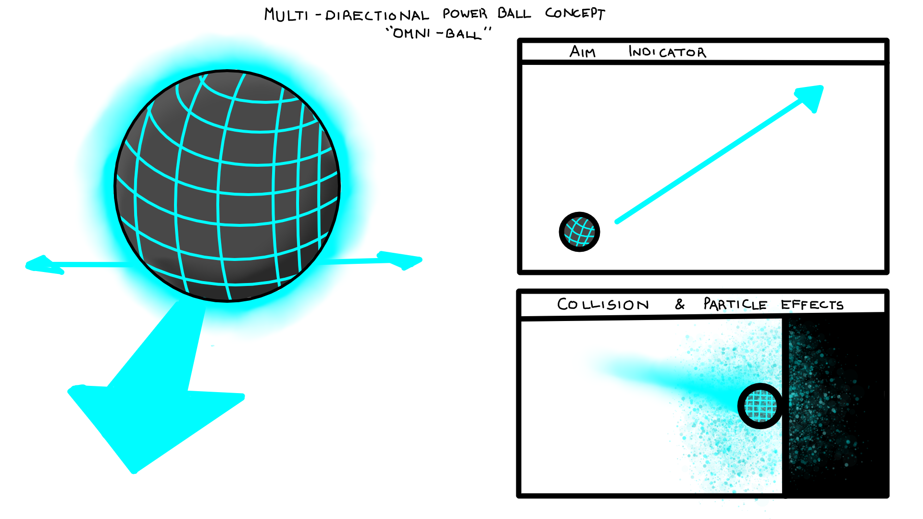
Notes:
The slide currently shown is the concept for the multi-directional ability ball, which I’ve dubbed as the omni ball. For each ball design, we attempted to create Unique and ability ball designs, that indicate to the player that this specific ball is in use, rather than telling them. In conjunction to the design, a different trajectory line indicator is also designed for each ball, further emphasising to players that this ball is in use. Each ball also has its own collision and particle effect system, showing what each balls effect is, and its impact in the environment.

Slide 10
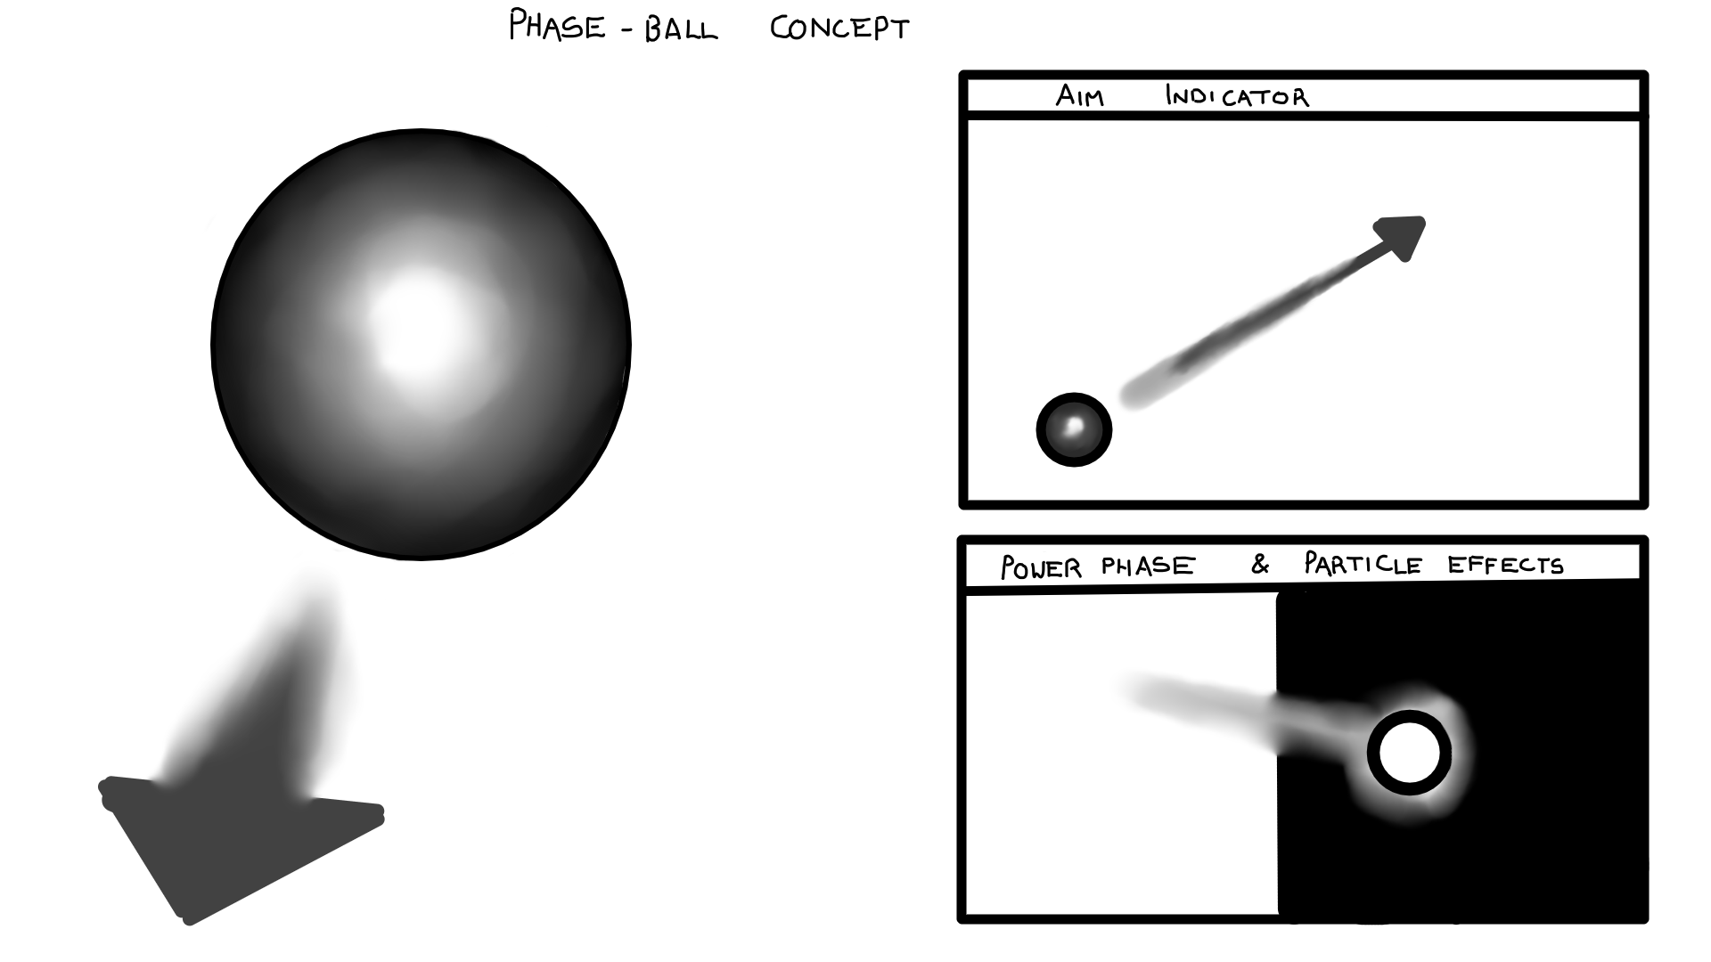
Notes:
A phase ball cannot have the same effect as the previous omni ball concept. You cannot have it colliding with a wall exploding with particle effects, indicating an impact when its supposed to phase through. Rather we utilise different visual clues for each ball and its properties, giving each its own aesthetic and identity. This is how we approached our communication design as we to need indicate to players in other ways rather than directly telling them or the excessive use of texts, so that its easily recognisable yet still conveys vital information.

Slide 11
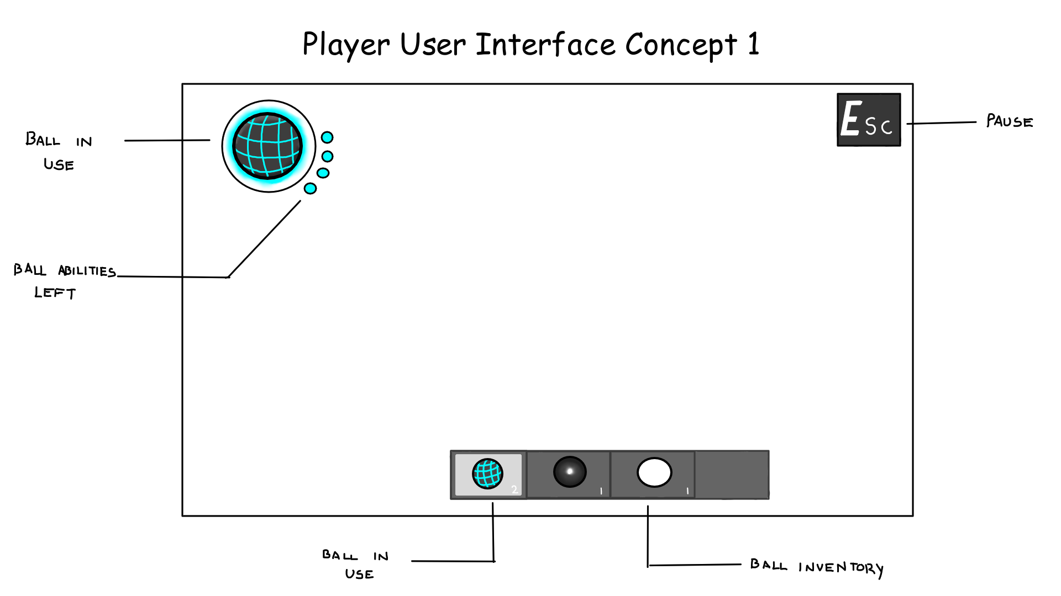
Notes:
For the User interface, the idea of Using symbols to convey info to the player rather than words was essential. There are multiple examples where visual indicators provide vital information to the player. Rather than telling the player which ball is in use, a symbol for ball can be displayed instead. A symbol of dots can be utilised to the player of ow many number of abilities. There are also Numbers to indicate how many of each ball variant is still left as well as a highlight to further emphasis the which ball is in use

Slide 12
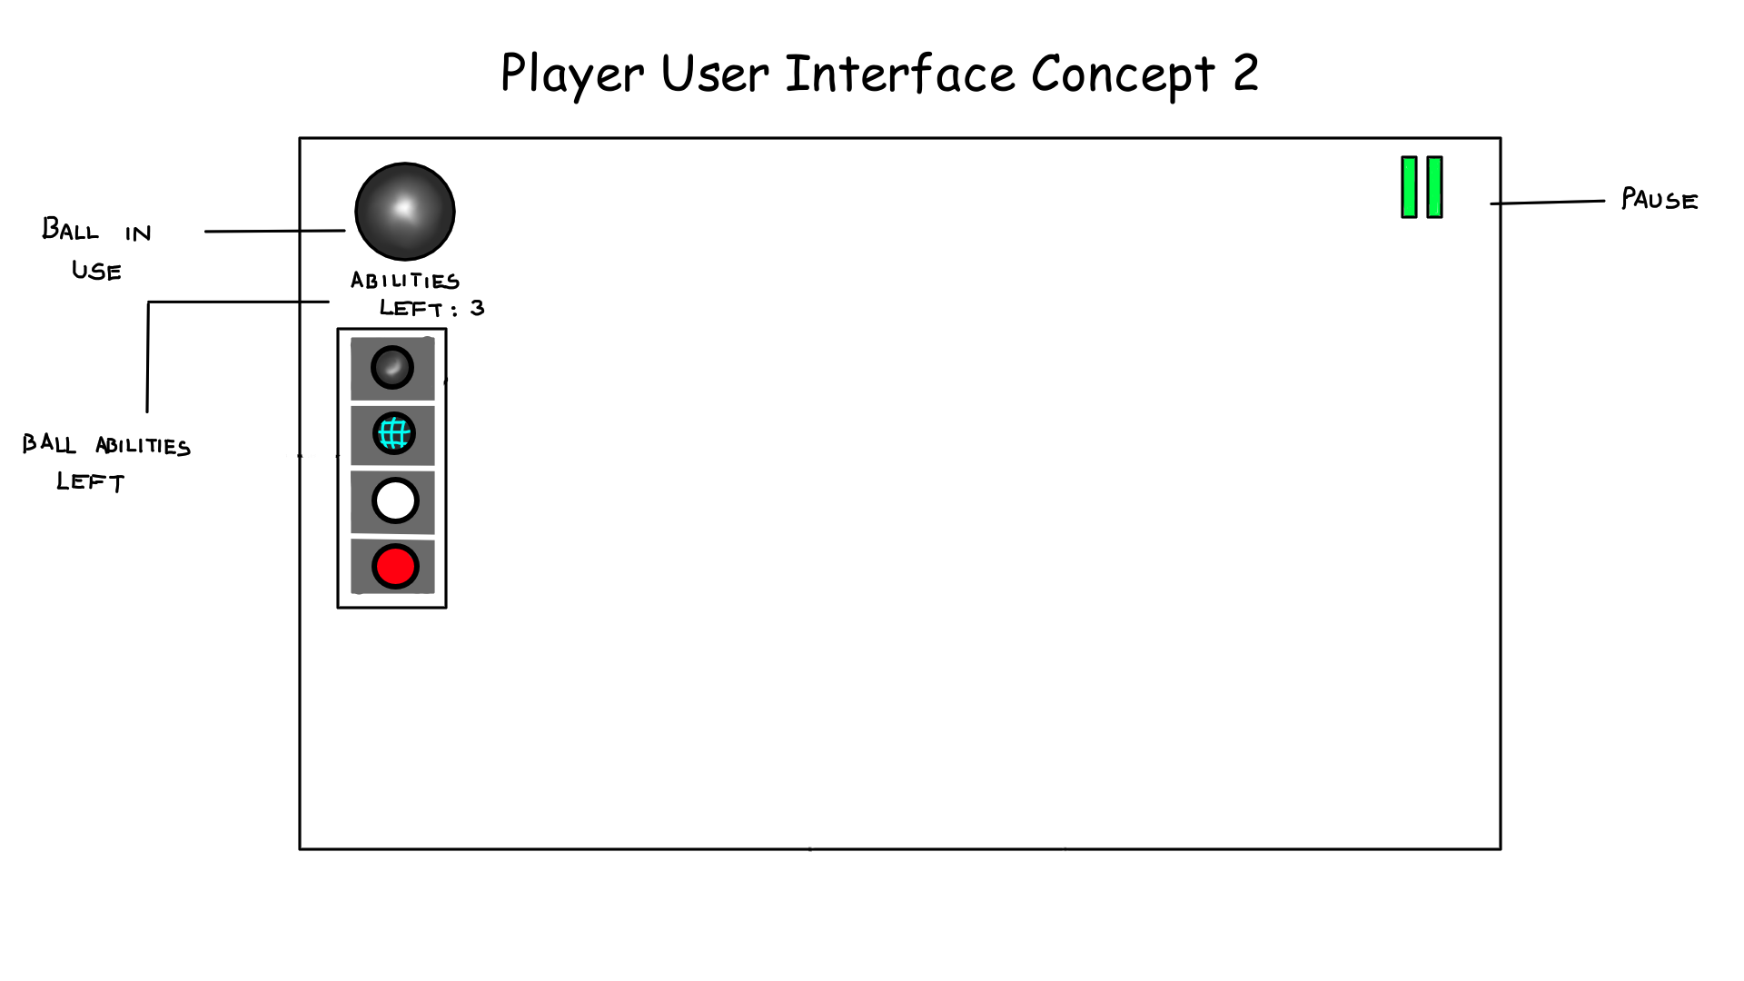
Notes:
The user interface concepts also allowed us to indicate and action and/or button prompt to the player. The only question that arose each time was “How can we make this multi-platform friendly” as well as still convey vital info to the player without an excess of symbols. We needed to identify which info is vital to the player and how could we substitute any symbols for a multi-controller output. You cannot have an “escape button prompt” to pause when you’re playing with a controller or vice versa. Therefore these small additions to the UI provide vital information through the use of easily recognisable visual indicators and effects with only text used if necessary such as return to men or explaining something that requires words.

Slide 13
Game Design Process
Start
develop a prototype to begin basic playtesting
Then
Incorporate:
ability mechanics development
environmental game objects
Collect data:
for finalizing the tuning of mechanics
Resolve:
any other issues regarded from playtesting
Lastly
polish the final product
include user interface elements

Slide 14
Tasks
Tasks are geared to milestone completion
Order of tasks is based on dependencies
Wants, Needs, and Dreams
Notes:
Tasks are geared towards milestone completion, and are used to drive the development in a logical flow. The tasks are set out in a an order of dependencies. Each task is assigned as either a ‘Want’, ‘Need’, or ‘Dream’. This assignment let the designer understand the priority level of each task.
For Example:
A milestone is: ball ability mechanics have been programed to behave as intended
Some example tasks for this Milestone:
Need - Create the ability ball and add it’s physics controller.
Need - Create at least 2 abilities for this ball
Want - Create extra ball abilities.
Dream - Add animations and sounds to power ball Game objects
Next slide

Slide 15
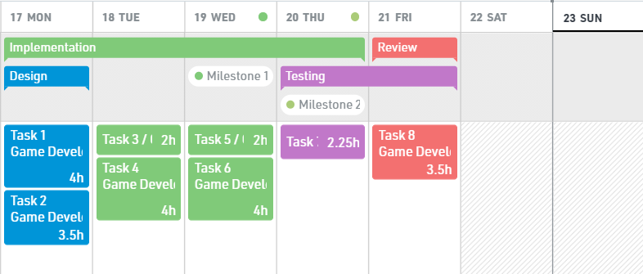
Scheduling
Example week of phases, milestones, and tasks
Notes:
Good scheduling is imperative to have a successful project, that hits all its milestones and tasks. The schedule is used to drive milestone and task achievement. The schedule is broken up into 4 week sections. The image being shown depicts an example week of the schedule. Each week is broken up in a ‘design’, ‘implementation’, ‘testing’ and ‘review’ phase. The schedule is also used to drive iteration and testing. After every testing phase, there is a review phase which will be used to review play testing data and feedback. The review phase in conjunction with the design phase will be used to decide on any iterations and changes that should be made to the game. The associated documents should also be updated to be inline with this new iteration of the project.
next

Slide 16
Risks
Load Shedding
Risk Level: Primary
2. Illness
Risk Level: Secondary
3. Internet Failure (Unrelated to electricity failure)
Risk Level: Tertiary
Overcoming and planning:
Schedule has no work on weekends, this time must be used in the event of delays
Notes:
There are 3 main risks that we my face. Each risk has been given a ‘Risk level’, this ranges from primary to tertiary. The main risks are Load Shedding, Illness, and Internet failure.
Scheduling has been used to try mitigate the effects that these risks may have. No work has been scheduled for the weekend. This time must be used to catch up on any work missed, due to risk effects. Trademark Alan inc.

Slide 17
Thank You For Your Time
:)

Slide 18
James Theron - 1901870
Alon Mizrahi - 1405583
Ashish Jugpall - 2273877
Tenisha Moodley - 2105982

